Slide 1
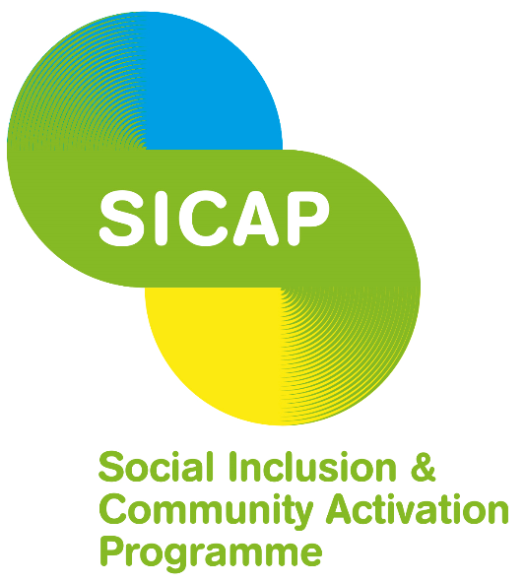
Social Inclusion Community Activation Programme
Local Community Development Committee Information Session
Maria Farry

Slide 2
Focus of Presentation
To provide a flavour of activities being delivered in this region under the following SICAP Goals:
  Goal 1 - Empowering Disadvantaged Communities
  Goal 2 - Lifelong Learning
  Goal 3 - Employment

Slide 3
Goal 1 Activity in 2015
Community Development Skills Training – Cork West District
Collaborative Networks in Kerry
Community Group Development
in Limerick
Support for New Communities in Bandon & Kinsale
Notes:
Community Development Skills Training - A training programme was developed with 6 modules; Running effective community meetings, Roles of Officers, Finance, Community Development Principles, Strategic Planning and Supporting Volunteerism. The programme was delivered in a group format in Clonakilty where 4 LCG’s participated.
Collaborative Networks - the primary beneficiaries were the local community networks including the Environment Network, SAOI Network and the Women’s Forum. - The Duhallow Women's Forum was developed with the aim of enhancing the participation of women in community development and local decision making. The Forum has facilitated a number of Network Meetings in 2015 allowing the opportunity for women’s groups from Duhallow to collaborate and network with each other and has allowed for the sharing of information and ideas. It continues to succeed in the building of confidence levels of women in the region through encouraging their participation in a wide range of training courses, workshops, seminars and conferences.
46 Local Community Groups received support, advice, information, mentoring etc in relation to organisational development and governance. 9 Local groups received funding from other sources as a result of SICAP support with application processes.
Failte Isteach initiative successfully established in Kinsale - peer-support self-help groups among new communities.
LCDC identified a range of issues presented e.g. difficulty with language, integration and isolation.
Image: Members of the SICAP-supported Inter-Agency Network – Learning Limerick Strategic Steering Committee - at the launch of the 2015 Learning Limerick Festival.

Slide 4
Support for New Communities
The WCDP identified that although there are English classes available in surrounding areas often these courses cover only the reading and writing of English language. The target group may have gained these skills but often lack the ability to converse. This is often due to a lack of opportunity to practice the use of English and a space to grow their confidence to use it.
SICAP Target Groups:
All members of New Communities in the Local Area. The services was operational in Kinsale from September 2015.

Slide 5
Activities:
Programme was established in Bandon / Kinsale towns
Programmes are delivered at three levels :beginner, intermediate and advanced level English, including grammar tuition
Topics range from:
  shopping
  going to the doctor
  dealing with your child’s school
Weekly meeting to bring together local community and new community members
Notes:
The Fáilte Isteach operating model has social inclusion at its heart, bringing together people in a local community and their new migrants to learn together working in small groups of 3/4 facilitated by a WCDP staff member

Slide 6
Summary of Achievements in 2015:
European Economic and Social Committee have just awarded Failte Isteach the 2015 EESC Civil Society Prize
15 members signed up from 7 different countries
multi-cultural Christmas food party was held
Weekly meetings have helped not only with language, but it also addressed issues of isolation
Greater awareness of local services, opportunities

Slide 7
SICAP Goal 2 Activity
Youth focused educational supports in Cork City
Combating Digital Exclusion Programme
Special Education Needs in South Kerry
Pathways to Progression in Monaghan
Notes:
Youth focused educational supports in Cork City – in Cork city focused on children and families in disadvantaged areas and Traveller children. This resulted in a vocational based training (in hair dressing) for young Traveller women and recruitment took place in 2015 of young Traveller men for a carpentry course. In total 100 young people received support through this action.
Combating Digital Exclusion Programme – Targeted the unemployed and people living in disadvantaged communities. This programme was delivered across 5 hubs in 2015 including Midleton, Cobh, Ballincollig, Carrigaline & Macroom.
44 individual participated in all with 44 successfully completing the 2 days of training. Key IT skills required were email application and general computer use
Special Education Needs in South Kerry focused on people with disabilities - Supported 70 people with disabilities through organised activity camps and workshops which all tied in with the New Directions Policy and demonstrates the abilities of young people and adolescents with intellectual disability. There is planned progression for all these groups in 2016 with the support of the education officer under SICAP.
Image: Innishowen women's group

Slide 8
Pathways to Progression
This aim of this action is to provide pre-development support to enable people to enter lifelong learning or to progress along the education continuum by building generic skills thereby ultimately increasing their chances of being able to re-enter the employment.
The participants came primarily from the following target groups:
People living in disadvantaged communities
People with disabilities
The Unemployed (including those not on the Live register)
Young unemployed people from disadvantaged areas

Slide 9
Activities
“The Focus Programme – Making Change Happen” was delivered in 5 locations in Co. Monaghan
A total of 53 individuals took part.
A mixture of individuals participated in the workshops – all unemployed, some never having worked, some not having worked for a long number of years, some with underlying mental health or literacy issues which prevented them making progress in employment.
The supportive group work nature of the training provided them with a new context through which to assess their own situation.

Slide 10
Summary of Achievements in 2015:
Making Change Happen” engaged 53 individuals
Many of the participants indicated increased levels of confidence and motivation on completion of the workshops
Of the 12 people surveyed for this case study who completed the Focus Programme,
  1 has gone onto secure employment,
  2 have commenced employment schemes,
  2 have progressed into further education
  2 have completed other short courses
  5 awaiting courses to start.
Feedback from the delivery agent highlighted that:
  “The majority of participants really cared about getting back to work, they just did not know how to go about it and how to make progress on their own.”

Slide 11
SICAP Goal 3 Activity
Ballyhoura Rural Employment Service
Support individuals from target group into self employment in Mallow & Fermoy
Client Engagement – Employment in Limerick City
Enterprise and self-employment initiatives in Cork City
Notes:
Ballyhoura Rural Employment Service - Targeted employment information, Outreach clinics and one to one and group based pre-employment advice, Accredited and non-accredited training programmes – 135 clients benefited from the service.
This action supported over 80 clients in 2015 and succeed in getting 20 into self employment.
3. Client Engagement – Employment - 12% of the total caseload were aged under 25 and not in education, employment or training (NEET).
- Guidance on how and where to search to employment opportunities
- Interview preparation
Completion of applications for education and training courses
Image – Mayo Business - Winner Michael Mc Greal: The Wild West “My business would have been impossible without the programme. To have the security behind the business with this programme was amazing”.

Slide 12
Enterprise and self-employment initiatives
Cork City Partnership provided a range of pre-start and post start-up supports for unemployed individuals who wanted to start their own business.
Since the introduction of the SICAP programme in April 2015 Cork City Partnership has received referrals and enquiries from a number of agencies about enterprise supports and training. This includes referrals from the Dept. of Social Protection, Local Employment Services, Citizens Information Service and individual self referrals.
Target Group:
Long Term Unemployed
People living in disadvantaged areas

Slide 13
Activities
  Enterprise information workshops - bi-weekly basis and accommodate up to 25 people at each session
Topics Covered:
Is ‘starting a business’ the right option for you?
Enterprise support and training
The Back to Work Enterprise Allowance schemes
Meeting the qualifying criteria before applying for BTWEA /STEA
Assessing your business idea and drawing up a business plan
Funding the business start up and the legal status of the business
Network and mentoring to develop your idea into a sustainable business

Slide 14
Summary of Achievements in 2015:
477 individuals registered and attended the enterprise information workshops in nine months
180 people have progressed into self employment
Good collaborative working relationship built with DSP, Local Enterprise Office and LES
15 different nationalities supported under this action
Notes:
Difficulties/barriers
Because of low number of people from the under 25 age bracket referred to us in first instance, we found it difficult to deliver 10 start-ups in this category. However we did manage to get 6 young people to start their own business within the first 9 months of SICAP.
The number of people who express an interest are quite high at first. After 2 or 3 interventions the participation rate can drop substantially as many people recognise that self-employment is not an option for them.
language and literacy skills are particular barriers for our client group
Access to start up funding has always presented a challenge and is a very real barrier to progression for some individuals.

